Slide 1

Harmonizing Federal Health Information Models and Standards In Laboratory Domain for Public Health
Authors
Kosta Makrodimitris, PhD, MSc, Office of the Commissioner, US Food and Drug Administration,
Nikolay Lipskiy, MD, DrPH, MBA, OSELS/PHITPO/DIPPC, CDC,
Steven Wagner, MA, PMO of FHA Standards Program, ONC- contractor,
Cynthia Vinion, MEA, NORTHROP GRUMMAN, contractor for CDC
Galen Mulrooney, MBA, Chief Health Informatics Office, US Veterans Health Administration
The findings and conclusions in this report are those of the authors and do not necessarily represent the official position of the Centers for Disease Control & Prevention (CDC), US Food and Drug Administration (FDA), US Veterans Health Administration (VA), or the Office of the National Coordinator for Healthcare Information Technology (ONC)
2011-08-22, Atlanta,
C6 Federal Health Information Models and Architecture, and Best Practice Analysis– Standards and Sharing for Success

Slide 2
ACKNOWLEDGEMENT
Federal Health Interoperability Modeling & Standards, (FHIMS) ONC/FHA
ONC Standards and Interoperability Framework Initiatives (LRI, PH-R)
DHHS,CDC Office of Surveillance,Epidemiology & Laboratory Services
DHHS, USFDA, Office of the Commissioner
DoD/MHS
CMS
NLM
SSA
VA/VHA
NCI/NIH
SAMHSA
HL7 (Orders and Observation, ArB, EHR WG)

Slide 3
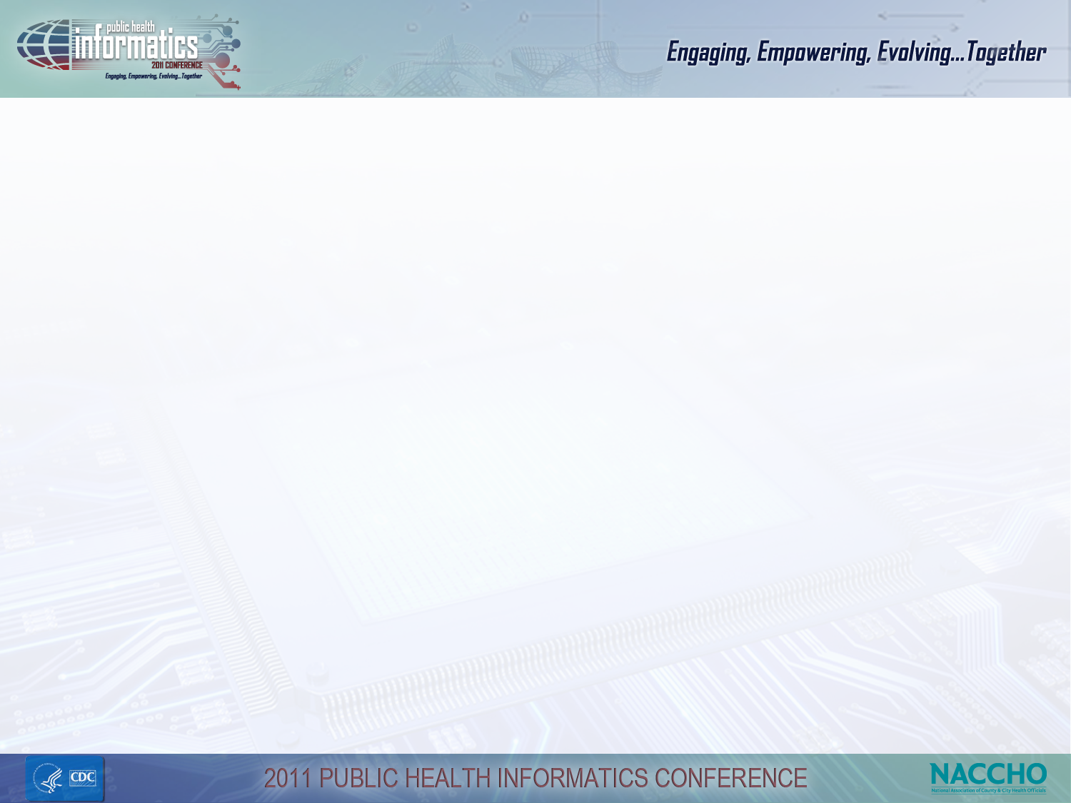
OUTLINE
Background FHA/FHIM project
Background FHIM/Lab domain
FHIM/Lab domain cases
FHIMS/Lab architecture/interfaces
Background S&I Framework/LRI
Mapping FHIM to S&I lifecycle
FHIM : Lab specimen model
Use cases (lab test-reports-results)
  Clinical/EHR generic case
  Genetic testing
  Sentinel
  Others ...
Future efforts
Notes:
This presentation describes efforts of the Office of the National Coordinator (ONC) Federal Health Information Modeling and Standard Working Group (FHIMS WG) Laboratory Domain to produce a logical, business-focused health information model along with a terminology model that supports laboratory data interoperability by harmonizing information from the Federal partners and standards organizations.

Slide 4
Background – FHA Information Modeling Project
Purpose of the project: develop initial interoperability information and terminology models for use by Federal partners
  Information Models - to address consistency and provide the basis for information interchange
  Terminology Models - to produce semantically consistent and interoperable content
Widen participation and focus beyond Federal partners to state & local and industry partners
Sponsor/Lead Partners: VA/VHA and DoD, DHHS

Slide 5
Background – FHA Information Modeling Project
Develop a Federal Health Information Model (FHIM) - a logical, platform independent, UML model
Divide health into domains of information (e.g., Lab domain) and develop the FHIM by modeling each domain
Domains Currently Being Modeled
Lab (modeling iteration 4 of 5)
Medications/Pharmacy (including Immunizations) Orders (General)
Domains Scheduled to Be Modeled: Vital Signs, Encounters
Domains Already Modeled
Person Security and Privacy Eligibility,
Enrollment, Coordination of Benefits,
Behavioral Health Assessments Problems, Allergies
(Total # of information domains to model approximately ~60)
Domains Suggested
Telemedicine
Medical Devices
Public Health (currently in the list)

Slide 6
Background FHIM/Lab Domain
Identify the federal, state, and local agencies and private organizations participating in ONC's efforts
Utilize ONC products as a basis for the design and development of interoperable
Laboratory interoperability within systems
Validate existing laboratory data exchanges and interoperable systems against the products of the ONC initiatives such as Meaningful Use
Leverage previous efforts
HITSP(EHR-Lab, Biosurveillance)
HL7 (ELR, O&O, ICSR, CDA..)
LOINC, SNOMED
CLIA, CAP, COLA, AOA, JC, APHL, ...
ICLN, FERN, LRN,

Slide 7
FHIM/Lab Domain Cases
Focus on lab data exchange information including order, results, lab reports, specimen information, subject demographics, etc
Develop scenarios and use cases for exchange of lab data
Develop logical model of exchangeable lab information
Recommend lab terminology and standard vocabulary
FHIM Laboratory domain has identified public health use cases and sub-domains which include but not limited to,
genetic testing,
disease registries (cancer),
public health laboratory data exchange,
testing for active (sentinel, medical products) surveillance
syndromic (diseases) and passive, active surveillance
laboratory interoperability
response networks (food safety)
others

Slide 8
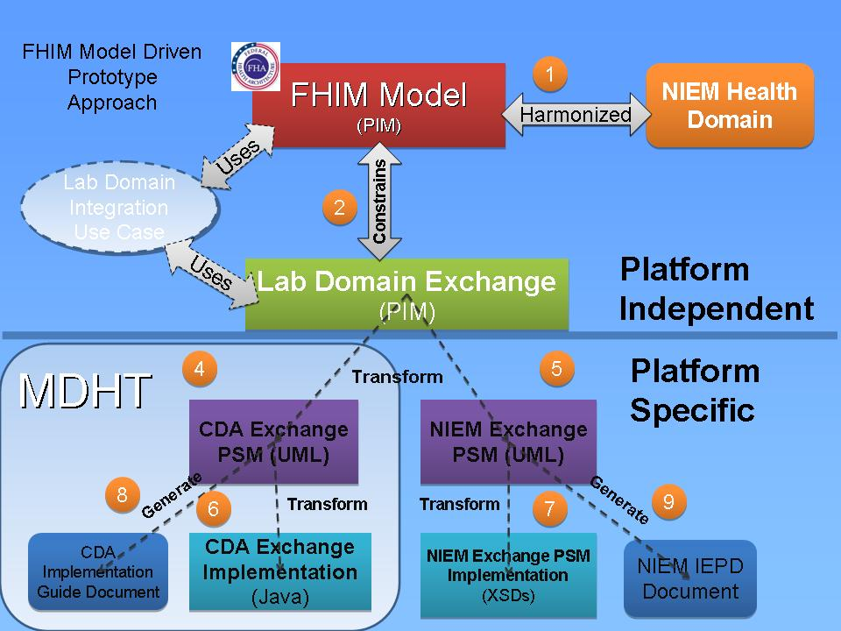
Lab domain architecture/interfaces
Acronym
NIEM: National Information Exchange Model
MDHT: Model Driven Health Tools
CDA HL7: Clinical Document Architecture
UML: Unified Modeling Language
PIM: Platform Independent Model
PSM: Platform Specific Model
XSD: XML Schema Definition
IEPD: Information Exchange Package Documentation

Slide 9
Background - Standards & Interoperability (S&I) Framework
An ONC effort to bring together government and industry experts to collaborate on Meaningful Use interoperability challenges
Organized into initiatives each focused on a specific meaningful use challenge
S&I Laboratory Results Initiative
  Address the challenge of lab reporting to ambulatory primary care providers.
  Address the challenge of having two standards specifications for ambulatory laboratory reporting, neither of which are adopted universally across the industry.
  Consider the needs of public health electronic laboratory reporting (ELR)
See http://wiki.siframework.org/ for more information

Slide 10
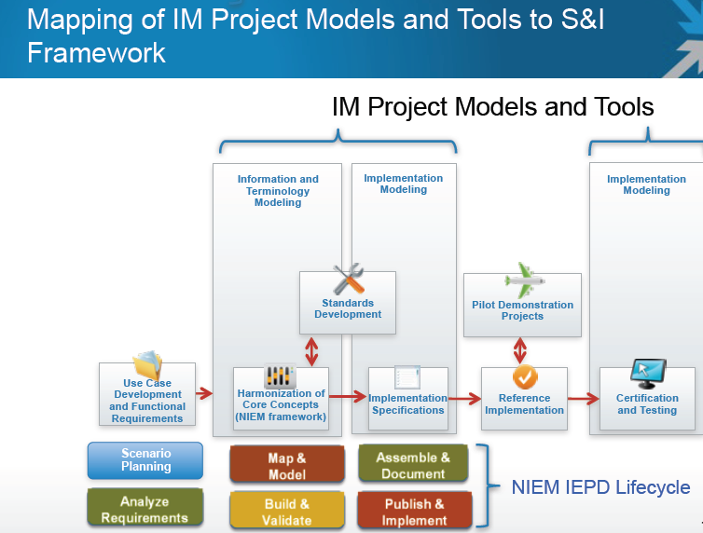
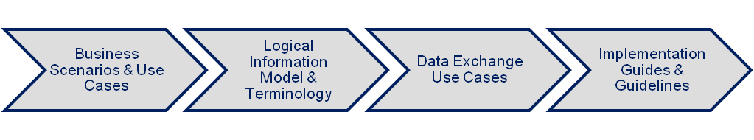
FHIM Lab
S&I LRI
FHIM
MDHT
MDHT
http://wiki.siframework.org/
http://healthit.hhs.gov
http://fhims.org
Notes:
IMPLEMENTATION TOOLS/OPEN SOURCE THAT S&I MAY LEVERAGE

Slide 11
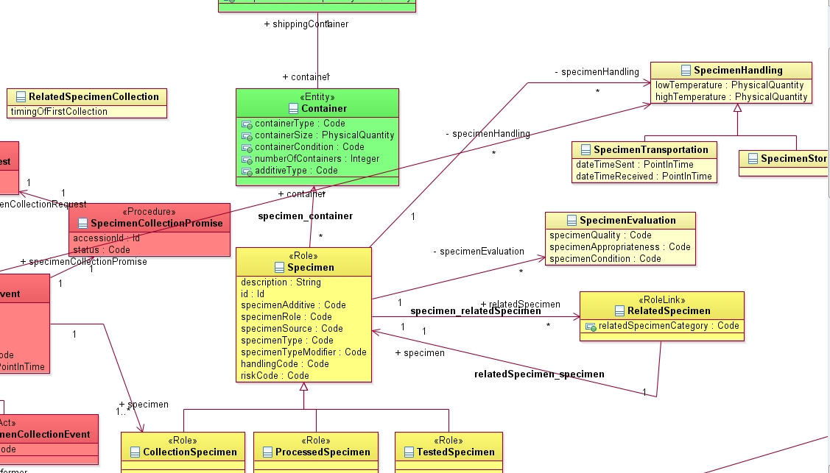
FHIM model snapshot: specimen
terminology
terminology
terminology
terminology
terminology
https://www.projects.openhealthtools.org/sf/projects

Slide 12
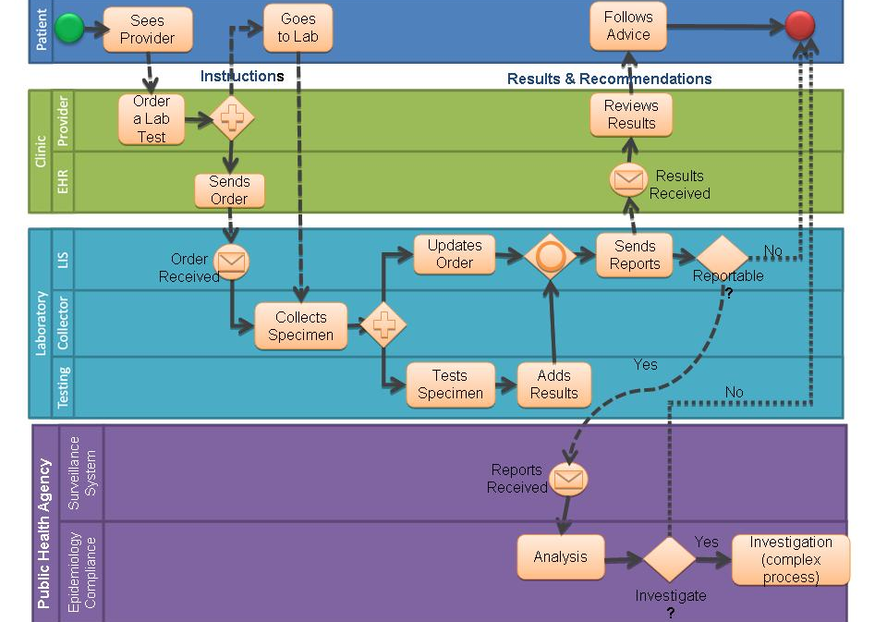
Generic Business diagram for clinical/EHR case
Presented at AAAS 2011 International annual meeting, Feb 2011

Slide 13
Genetics test Case (Dr Lubin , Dr. Pollock CDC)
Mutation
database,
Registry
Mutation
database
Registry
Perform test, Lab interpretation
Report result
Lab
Specimen
collection
Blood
Drawing
Genetic
Counselor
Test counseling
- informed consent
- additional
patient/family
info collected
- test order
Receive
results
Physician
Clinical contact
- Collect patient/
family information
Patient

Slide 14
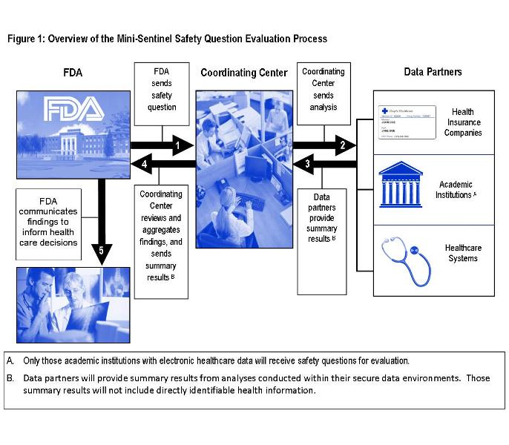
Sentinel model nationwide/EHR
http://www.fda.gov/Safety/FDAsSentinelInitiative/ucm149340.htm
Dr Racoosin, Dr. Rocca & Sentinel team, FDA July 2011

Slide 15
Future efforts
Use Cases: EHR, genetics, surveillance, food, environmental, emergency response
CLIA, COLA,CAP,JC, AOA, AABB, ASHI and other accrediting related agencies
Interface with ONC S&I Framework: LRI & PH-R, Health Queries
Intra-domains at FHIM: Public health component/model
Terminology integration, SNOMED, LOINC
Clinical information models, HL7, openEHR
Environmental & Food safety exchanges
HL7 v3, ICSR, CDA, RIM alignment

Slide 16
APPENDIX

Slide 17
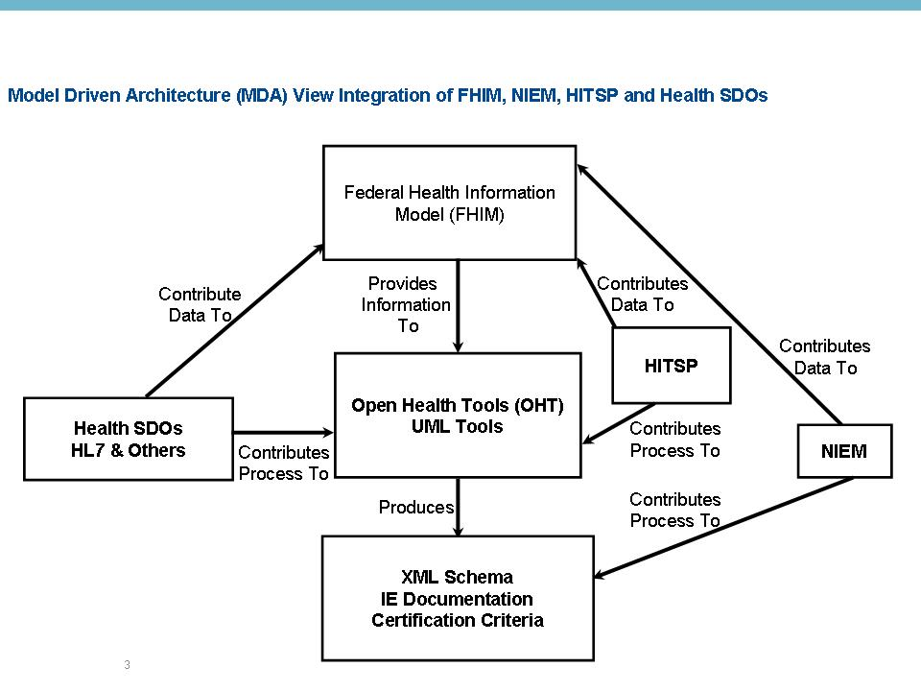
FHIM ‘Big picture’

Slide 18
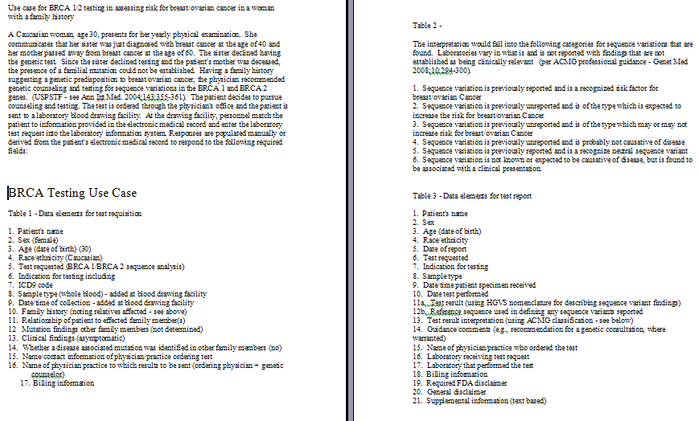
GENETICS TESTING (Dr Lubin , CDC)

Slide 19
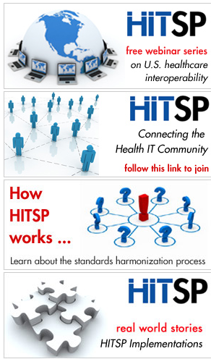
National relevant Data exchange initiatives
The American National Standards Institute (ANSI) Healthcare Information Technology Standards Panel (HITSP) purpose and function in defining healthcare information standards
  HITSP was created in 2005(ended 2010) as part of efforts by the Office of the National Coordinator for Health Information Technology (ONC, part of the United States Department of Health and Human Services) to promote interoperability in health care by harmonizing health information technology standards. HITSP is chaired by John Halamka, MD, CIO
  Relevant Cases and IS developed
    Electronic Health Record (EHR) Laboratory Results Reporting IS01
    Biosurveillance IS02
    Public Health Case Reporting Use Case IS011
www.hitsp.org
Notes:
PHIN:
The CDC Public Health Information Network (PHIN) is a national initiative to improve the capacity of public health to use and exchange information electronically by promoting the use of standards and defining functional and technical requirements. PHIN strives to improve public health by enhancing research and practice through best practices related to efficient, effective, and interoperable public health information systems.
CDC’s role in PHIN is:
Supporting the exchange of critical health information between all levels of public health and healthcare,
Developing and promulgating requirements, standards, specifications, and an overall architecture in a collaborative, transparent, and dynamic way,
Monitoring the capability of state and local health departments to exchange information,
Advancing supportive policy,
Providing technical assistance to state and local health departments, and
Facilitating communication and information sharing within the PHIN community.
One of our primary goals is to harmonize public health information exchange with the Nationwide Health Information Network
LIMSi:
The Laboratory Response Network (LRN) is a coordinated network of public health and other laboratories for which CDC provides standard assays and protocols for testing biological and chemical terrorism agents. LRN Results Messenger (LRN RM) was created to provide LRN laboratories with the ability to manage and share standard laboratory results data securely with public health partners. LRN RM represents the first step in an incremental approach to providing full standards-based electronic data exchange for this vital laboratory network. While the application is not intended as a substitute for a fully-functional laboratory information management system (LIMS), it is important for all LRN laboratories to be prepared.
The LIMS Integration (LIMSi) project is a parallel effort to LRN RM. It represents the next generation of the incremental approach to data exchange for the LRN. Its purpose is to enable laboratories to fulfill data exchange needs for the LRN using their own systems. LIMSi is currently facilitating collaborative efforts between CDC and public health laboratory subject matter experts to refine system requirements needed to configure LIMS to manage LRN testing. The LIMSi project is also creating a constrained version of the PHIN Laboratory Generic message guide that specifically targets the messaging and data mapping needs for the LRN.
ISDS Syndromic Surveillance:
In support of its mission, ISDS:
• Convenes the premiere international conference on syndromic surveillance
• Supports member committees in the areas of practice, research, global outreach, and
education and training
• Organizes Syndromic 101, an introductory course in syndromic surveillance
• Coordinates Distribute, an initiative that aggregates data from over 40 state and local
public health syndromic surveillance systems to provide a more comprehensive and
detailed awareness of geographic and age-specific patterns of influenza-like illness
In collaboration with the CDC ISDS recently created the HL7 implementation guide for syndromic surveillance for use by eligible hospitals and providers for Meaningful Use stage 1

Slide 20
Mini-Sentinel Year 2
(From Sentinel public presentation/updates 2011)
Sentinel Core Team Task Order
  Add laboratory and vital sign data to MSDD
  Continue methods development
  Develop anonymous linking between data partners (device registry and claims)
CDER Task Order
  Investigate safety issues with new molecular entities (newly approved drugs)
  Investigate safety issues with drugs that have been marketed for >2 years
  Investigate the impact of regulatory actions (e.g., restricted distribution)
CBER Task Order (PRISM2)
  A continuation of the active surveillance system developed in 2009 for H1N1 vaccine safety surveillance by HHS, FDA, and CDC
  Institute safety monitoring for a non-influenza vaccines
  Methods development for vaccine-related issues
An active surveillance initiative via intra-agency agreements with CMS, VA, DoD
Small distributed system
Each Partner has unique data infrastructure
No common data model being utilized
FDA proposes medical product – AE pairs to investigate
Develop a shared protocol
Assess interpretability of query findings resulting from a decentralized analytic approach and different patient populations
http://www.fda.gov/Safety/FDAsSentinelInitiative/ucm149340.htm
Dr Racoosin, Dr. Rocca & Sentinel team, USFDA July 2011

Slide 21
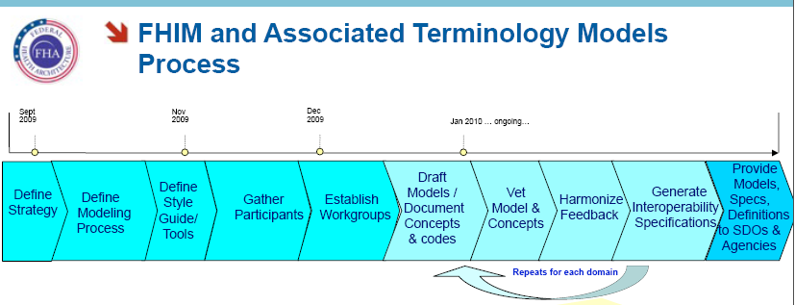
FHIM/Terminology Process

Slide 22
For more information please contact Centers for Disease Control and Prevention
1600 Clifton Road NE, Atlanta, GA 30333
Telephone, 1-800-CDC-INFO (232-4636)/TTY: 1-888-232-6348
E-mail: cdcinfo@cdc.gov Web: www.atsdr.cdc.gov

